Slide 1
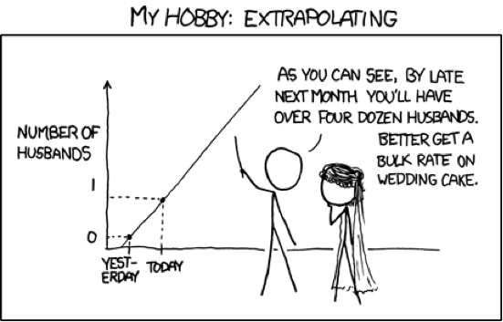
Support Vector Machines
Gosztolya Gábor
University of Szeged
Institute of Informatics
2023 / Apr / 20

Slide 2
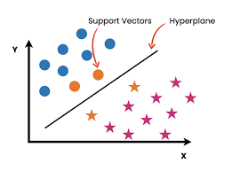
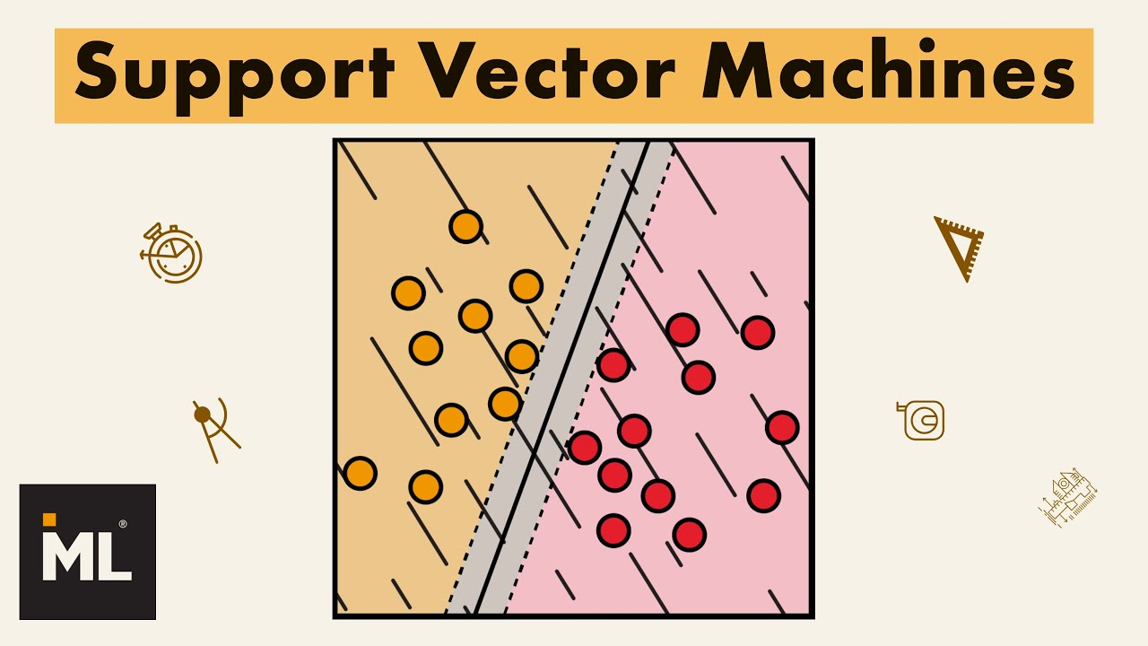
Support Vector Machines (SVMs)
Originated in 1979 by a paper by Vladimir Vapnik
The major development were invented mostly in the 1990’s
Its roots are in linear classification
But it has non-linear extensions
It has a very elegant (though very difficult) mathematical background

Slide 3
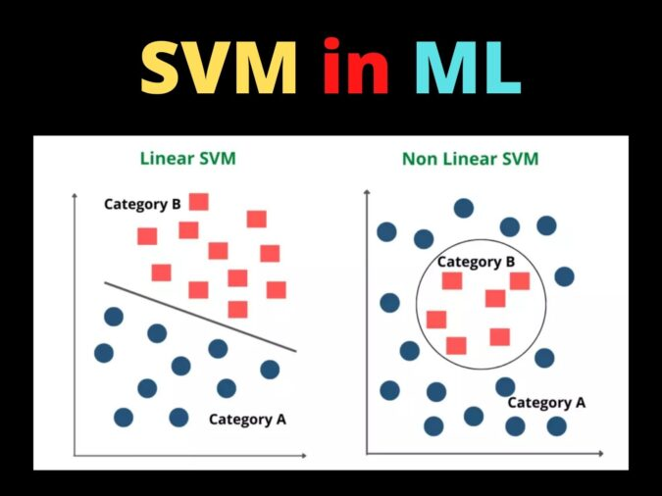
Support Vector Machines (SVMs) #2
The learning problem will be solved by quadratic optimization, which will lead to a globally optimal solution
It has been successfully applied to a lot of machine learning problems in the last 20 years
It was the most successful and most popular machine learning algorithm in the ‘90s
And it still might be useful

Slide 4
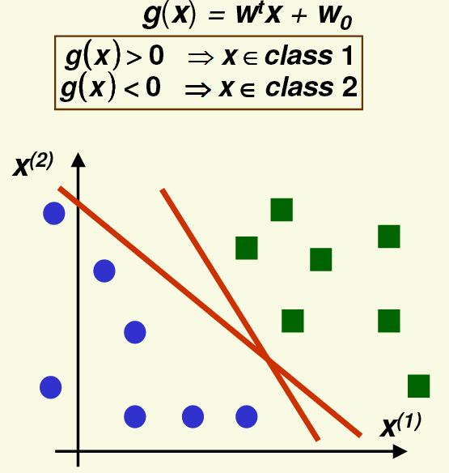
Let’s start with linear discriminant functions
In the linearly separable case usually there are a lot of possible solutions
Which one should we prefer from among the red lines?

Slide 5
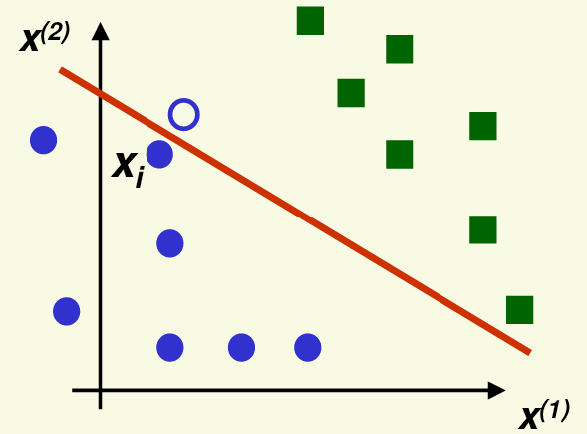
Linear discriminant functions
Remember that the training data items are just samples from all the possible data
Our goal is to generalize to unseen data
A new sample from a class is likely to be close to the training samples from the same class
So if the decision boundary is close to the training samples, the new sample will fall on the wrong side → misclassification
Our heuristic will be to put the decision boundary as far from the samples as possible, to improve generalization

Slide 6
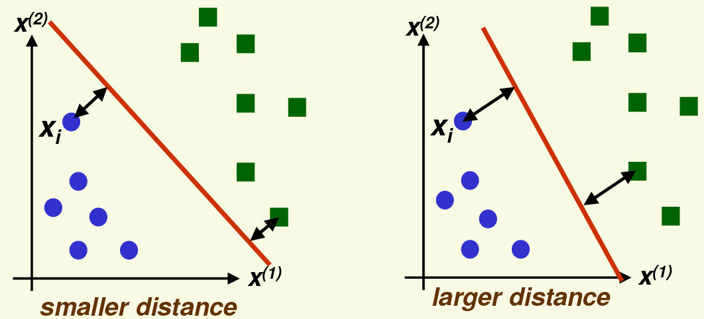
Support Vector Machines – Basic Idea
Our basic ideas will be to move the hyperplane as far as possible from the training data
The optimal hyperplane will have the same distance from the nearest example from class 1 and from the nearest example from class 2

Slide 7
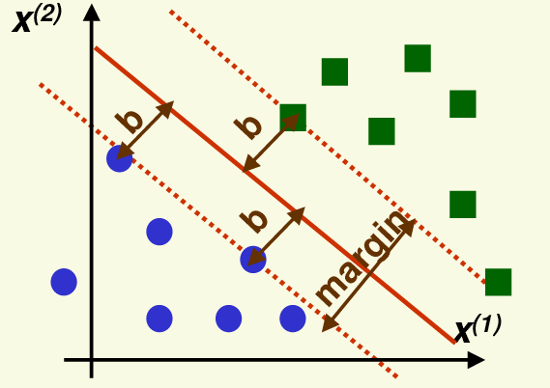
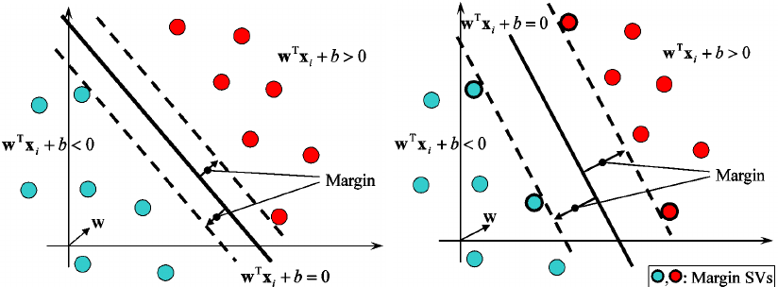
SVMs – Linearly Separable Case
SVMs will seek to maximize the margin (“largest margin” principle)
Where the margin is twice the distance of the closest example to the separating hyperplane
Maximizing the margin leads to a better generalization
Both in theory and in practice

Slide 8
SVMs – Linearly Separable Case #2
The support vectors are the samples that are the closest to the separating hyperplane
These samples are the most difficult to classify
The separating hyperplane is defined by the support vectors
But of course, we will know which samples are the support vectors only after finding the optimal hyperplane

Slide 9
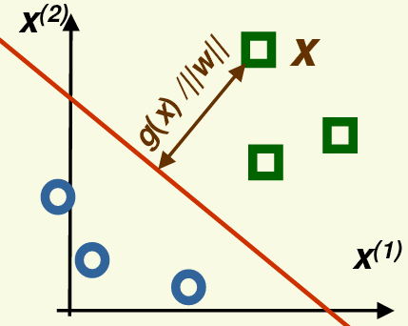
Formalizing the margin
Remember that the distance of any x point from the separating hyperplane where g(x)=0 is:
And the distance remains the same if we multiply g(x) by a non-zero constant:
This means that maximizing the margin does not uniquely define g(x)

Slide 10
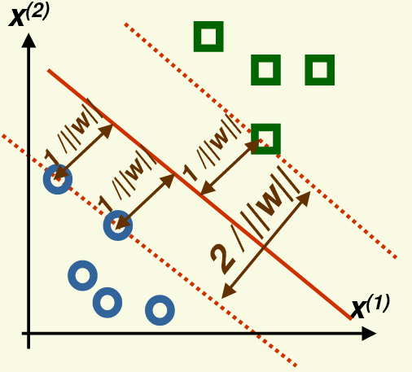
Formalizing the margin #2
To make the largest margin hyperplane unique, we also require . to hold for any support vector x_{i}
With this restriction, for all the support vectors:
And the size of the margin is:

Slide 11
Formalizing the margin #3
So we want to maximize the margin:
So that all the samples are correctly classified and fall outside the margin:
Similarly to the normalization step used for linear classifiers, we want to multiply the inequalities for the negative class by -1
For this, we introduce the z_{i} variables:

Slide 12
Maximizing the margin
We will maximize the margin by minimizing its reciprocal
With the constraint: z_{i}(w^{t}x_{i} + w₀) ≥ 1 ∀i
J(w) is a quadratic function, so it has a single global minimum
The optimization should be solved with satisfying linear constraints
This altogether leads to a quadratic programming task
According to the Kuhn-Tucker theorem, the problem is equivalent to
…where α_{i} are new variables
(one for each example)

Slide 13
Maximizing the margin #2
L_{D}(α) can also be written as:
…where H is an nxn matrix, and H_{ij} = z_{i}z_{j}x_{i}^{t}x_{j}
L_{D}(α) can be optimized by quadratic programming
Let’s suppose we found the optimal α=(α₁,…, α_{n})
Then, for each training sample, either α_{i}=0 , or α_{i}≠0 and z_{i}(w^{t}x_{i} + w₀ - 1) = 0
The samples with α_{i}≠0 will be the support vectors!

Slide 14
Maximizing the margin #3
We can calculate the w weight vector as:
…and we can obtain w₀ by taking any support vector x_{i} for which α_{i}>0:
The final discriminant function will be given as:
…where S is the set of support vectors
Notice that the discriminant function depends only on the support vectors, and it is independent of all the other training samples!
Since for those α_{i}=0 holds

Slide 15
Maximizing the margin #4
So the discriminant function is:
…where S is the set of the support vectors
And the discriminant function depends only on the support vectors, while it is independent of all the other training samples
Unfortunately, the number of support vectors usually increases linearly with the number of training samples
So even evaluating the model will be slow (although in theory w can be calculated up front, we will see later why is it not viable)
Training SVMs is slow as well
Requires operations with the matrix H of size nxn
Lots of efforts have been made to reduce the training time of SVMs

Slide 16
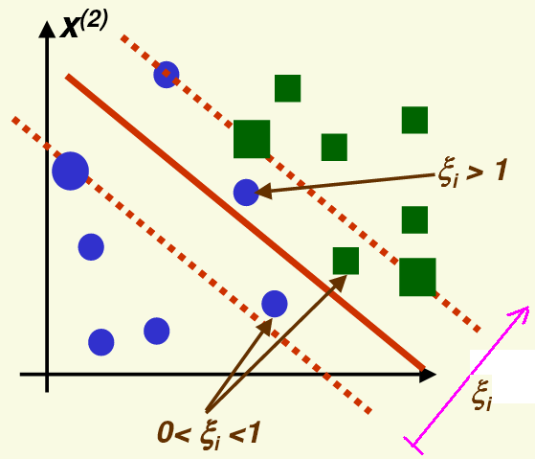
SVMs – linearly non-separable case
Most real-life tasks are obviously linearly non-separable
Can we still apply SVMs in this case?
Yes, but will have to allow samples to fall on the wrong side
We will punish these samples during optimization
For this we introduce the variables ξ₁,…, ξ_{n} (one for each training sample)
ξ_{i} will be the punishment of the ith sample
The value of ξ_{i} will depend on the distance of x_{i} and the margin

Slide 17
SVMs – linearly non-separable case #2
We introduced variables ξ₁,…, ξ_{n} (one for each training sample)
ξ_{i} is the punishment of the ith sample
The value of ξ_{i} depends on the distance of x_{i} and the margin
We use ξ = 0 for samples that are on the right side, and are also outside the margin
0 < ξ_{i} < 1 means that the sample is on the right side, but within the margin
ξ > 1 means that the sample is on the wrong side
We change the constraints: instead of z_{i}(w^{t}x_{i} + w₀) ≥ 1 we will use z_{i}(w^{t}x_{i} + w₀) ≥ 1 - ξ_{i} (“soft margin”)

Slide 18
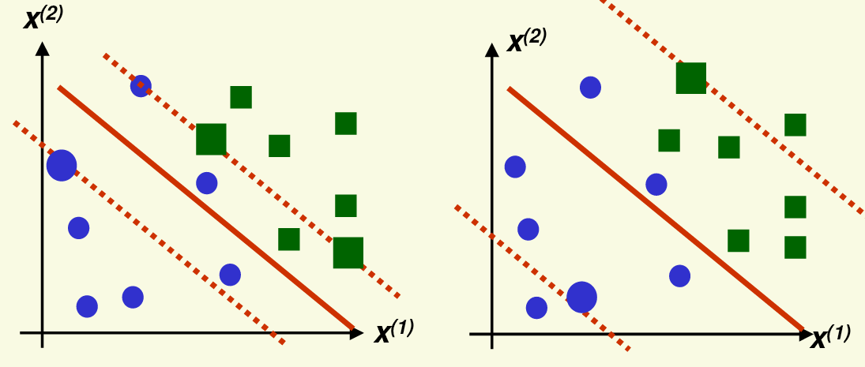
SVMs – linearly non-separable case #3
We extend the target function to be minimized as
Where C is a parameter which allows to tune the importance of the newly introduced “punishment term”
A larger C allows fewer samples to be in a suboptimal position
A smaller C allows more samples to be in a suboptimal position

Slide 19
SVMs – linearly non-separable case #4
So we have to minimize
With the constraints: z_{i}(w^{t}x_{i} + w₀) ≥ 1 - ξ_{i} ∀i and ξ_{i} ≥ 0 ∀i
The Kuhn-Tucker theorem turns this into the quadratic programming problem:
…which is quite analogous to the x linearly separable case
…one the constraints changed

Slide 20
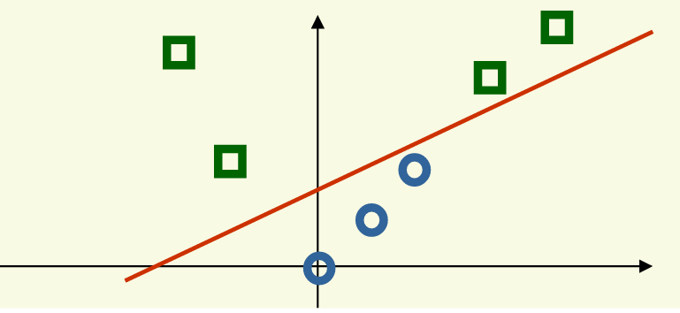
Nonlinear SVMs
The linear SVM still uses a linear discriminant function
It is not always flexible enough to solve actual real-life problems
We will create a non-linear extension of the SVM method by (non-linearly) projecting the training data into a larger dimensional space
Cover’s theorem: a pattern-classification problem cast in a high dimensional space non-linearly is more likely to be linearly separable than in a low-dimensional space
x→(x, x²)

Slide 21
Nonlinear SVMs #2
The function which maps the data into the new space is φ(x)
The steps of non-linear classification will be:
Project the data points into the new feature space using φ(x)
Find the linear discriminant function in this new feature space
Project the discriminant function back to the original space, where it won’t be linear: g(x) = w₁x + w₂x² + w₀

Slide 22
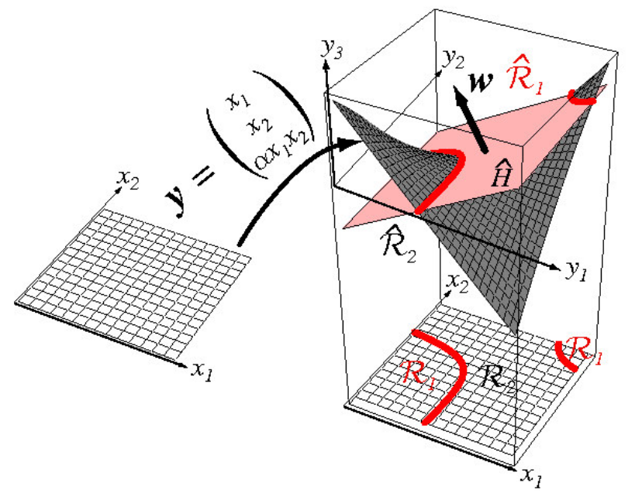
Another example

Slide 23
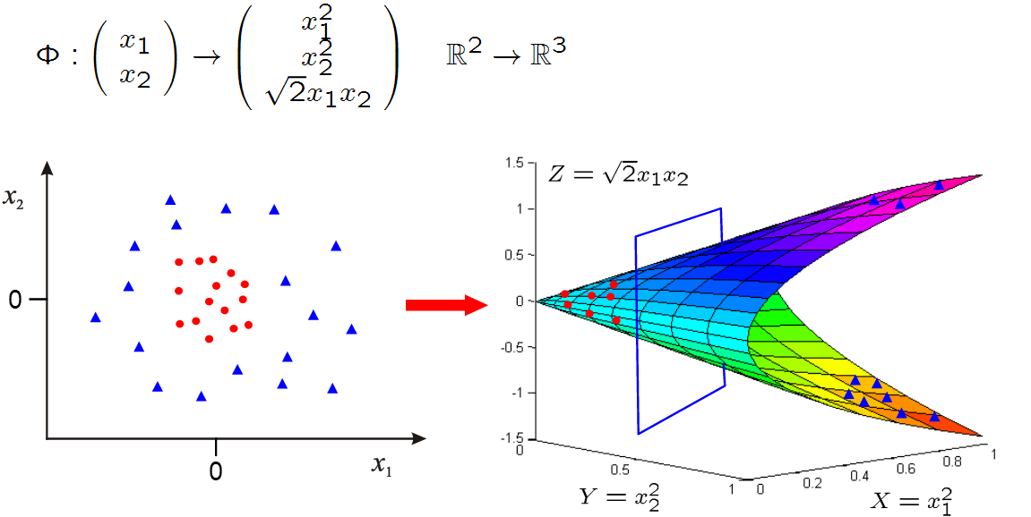
Yet another example…
The data is not linearly separable in the original 2D space, but it becomes linearly separable in the projected 3D space

Slide 24
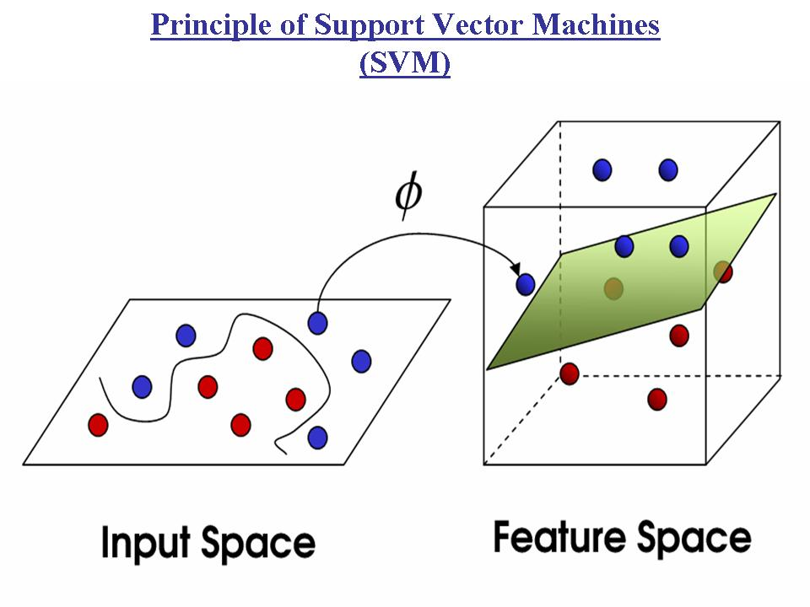
Classifying in higher dimensions
Projecting the data into a higher dimensional space makes the classes linearly separable
But what are the risks of working in a higher dimensional space?
The risk of overfitting increases (remember the “curse of dimensionality”!)
The computational complexity increases

Slide 25
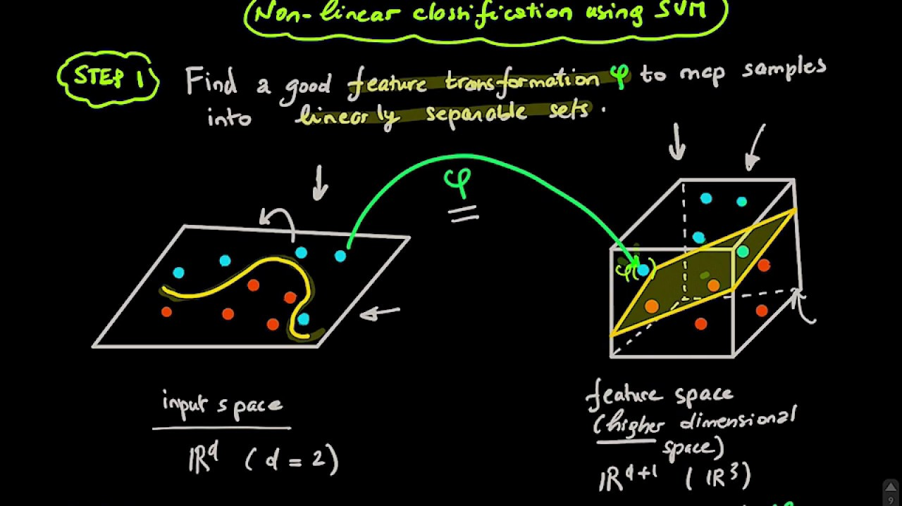
Classifying in higher dimensions #2
Fortunately, the SVM training algorithm is quite insensitive to the number of dimensions
It can be shown that the generalization capability of an SVM depends on the margin found, and not on the number of dimensions
Computation in the higher dimensional space can be performed implicitly by the use of kernel functions
This will allow us even to work in an infinite-dimensional space!

Slide 26
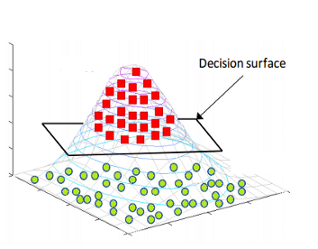
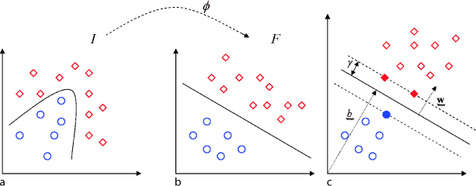
The inner product
The function to be maximized was formulated as:
It does not require the training vectors directly, only their pairwise inner products x_{i}^{t}x_{j}
…which is a scalar value!
If we project the samples into a higher dimensional space by using φ(x) instead of x, then the above formula will require φ(x_{i})^{t}φ(x_{j})

Slide 27
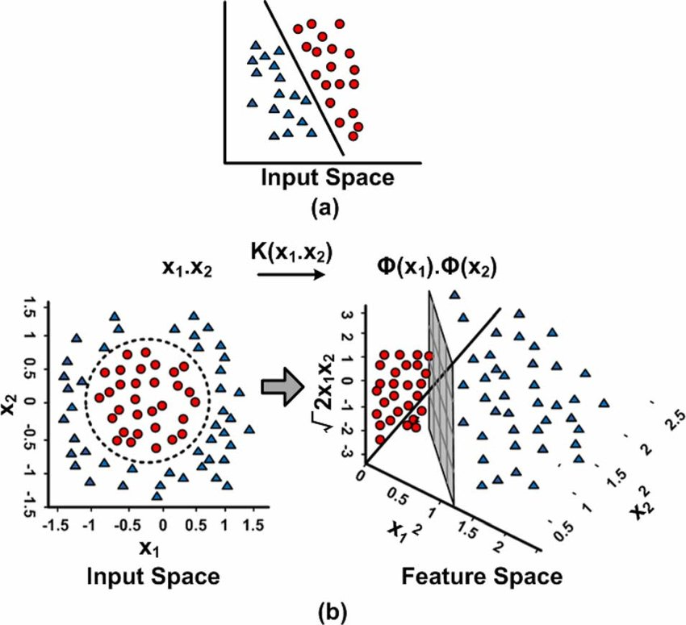
The “kernel trick”
So we need φ(x_{i})^{t}φ(x_{j})
We would like to avoid the computation of these inner products directly, as these φ(x_{i}) vectors have a high dimension
…so the multiplication would be slow
The solution (“kernel trick”): we find a kernel function K(x_{i}, x_{j}) for which K(x_{i}, x_{j}) = φ(x_{i})^{t}φ(x_{j})
Instead of calculating φ(x_{i})^{t} and φ(x_{j}) and then taking their inner product, we calculate only K(x_{i}, x_{j}) in the original lower-dimensional space

Slide 28
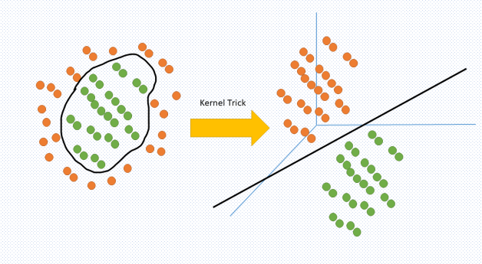
The effect of the “kernel trick”
So instead of calculating φ(x_{i})^{t}φ(x_{j}) (which is a scalar), we use a function for which K(x_{i}, x_{j}) = φ(x_{i})^{t}φ(x_{j})
So, instead of the function to be maximized:
…we can work with:

Slide 29
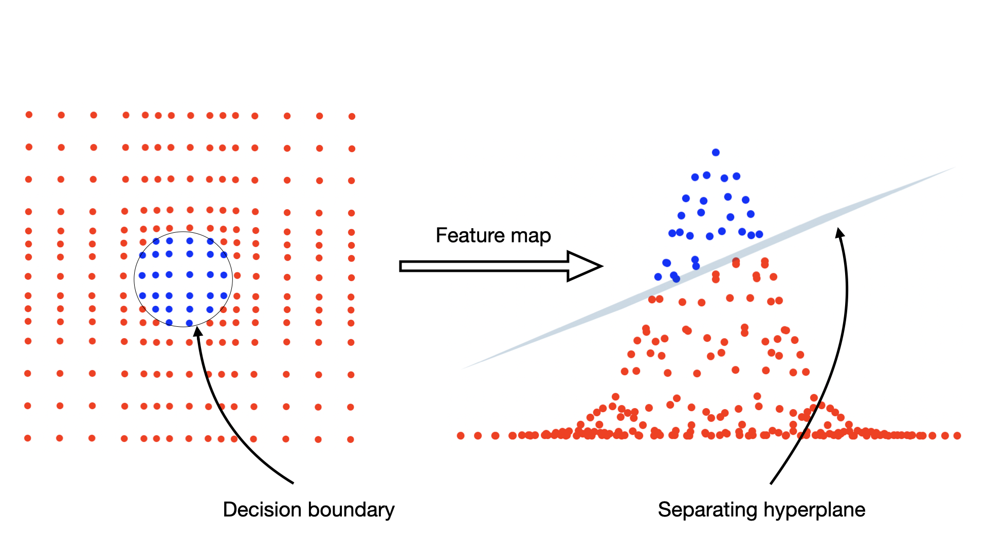
Kernel functions
Of course, not all possible K(x_{i},x_{j}) functions will correspond to an inner product φ(x_{i})^{t}φ(x_{j}) in a higher dimensional space
So we cannot just randomly select any K(x_{i},x_{j}) function
The Mercer condition tells us which K(x_{i},x_{j}) function in the original space can be expressed as a dot product in another space

Slide 30
Kernel function example
Suppose we have only two features
And the kernel function will be K(x,y)=(x^{t}y)²
We show that it can be written as an inner product:
We managed to write K(x,y) as an inner product with

Slide 31
Kernel functions in practice
As kernel functions are hard to find, in practice we usually apply some standard, well-known kernel functions
The popular kernel functions:
Polinomial kernel:
Gaussian or radial basis function (RBF) kernel (corresponds to a projection into infinite-dimensional space!):
For a huge list of possible kernel functions, see:
https://techvidvan.com/tutorials/svm-kernel-functions/

Slide 32
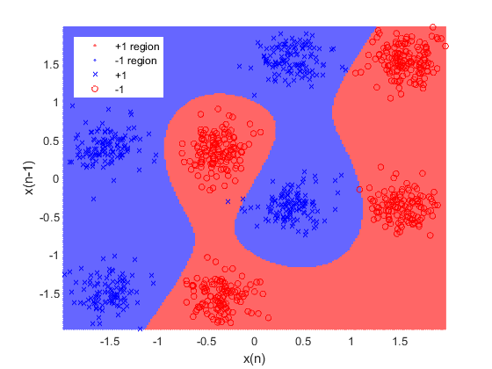
Kernel functions in practice #2
Unfortunately, in practice it is very difficult to tell which kernel function will work well for a given machine learning task
→ validation / development set…
The kernel function usually means an extra hyperparameter to set!
p for polynomial kernel
σ (γ) for the RBF kernel
…and we already had the C (complexity) hyperparameter…

Slide 33
The discriminant function
SVM finds a linear discriminant function in the high(er)-dimensional space: g(x) = wφ(x) + w₀
How will it look like in the original space?
Let’s examine only the case when the first component of φ(x) is 1, such as: φ(x) = [ 1 x⁽¹⁾ x⁽²⁾ x⁽¹⁾x⁽²⁾ ]^{t}
In this case wφ(x) will already contain a component which is independent of x. As it will play the role of w₀, we can restrict ourselves to discriminant functions that have the form g(x) = wφ(x)

Slide 34
The discriminant function #2
Remember that the linear SVM maximizes
If we project our data into a higher dimensional space using φ(x), than the problem turns into
For the linear case we obtained the weight vector as
…now it becomes:

Slide 35
The discriminant function #3
The discriminant function in the high dimensional space (in the “kernel space”) is linear:
The discriminant function in the original space will be:
…which will be non-linear is the kernel function is non-linear
…and this is also why we need all the support vectors at evaluation time
K(x_{i}, x) cannot be calculated up-front

Slide 36
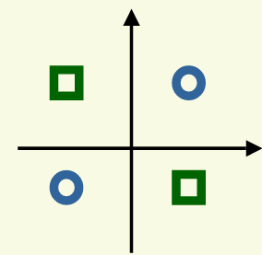
Example – The XOR problem
This is a two-class task with the following 2-2 samples:
Class #1: x₁=[1,-1] x₂=[-1,1]
Class #2: x₃=[1,1] x₄=[-1,-1]
This is the simplest task in 2D which is linearly non-separable
We will apply the kernel function K(x_{i}, x_{j})=(x_{i}^{t}x_{j}+1)²
…polynomial kernel, p=2
Which corresponds to the mapping (2D → 6D):

Slide 37
Example – The XOR problem #2
To obtain the solution, we have to maximize
…with the constraints: α_{i} ≥ 0 ∀i and α₁ + α₂ – α₃ – α₄ = 0
The solution: α₁ = α₂ = α₃ = α₄ = 0.25
So all 4 samples are support vectors ( α_{i} > 0 )
The weight vector is:
…which is: [ 0 0 0 -√2 0 0]
Which has only one non-zero component
The discriminant function in the transformed space is:

Slide 38
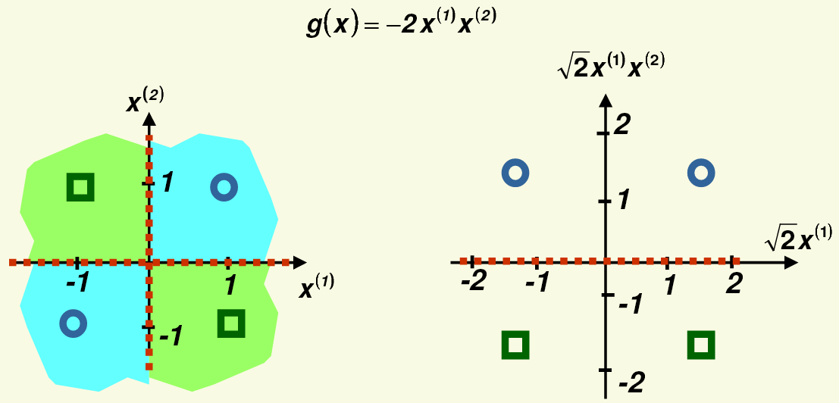
Example – The XOR problem #3
The decision boundary is where g(x)=0
It is non-linear in the original 2Dfeature space
while it is linear in the new 6D feature space (from which only 2 dimensions are shown in the figure), and it also correctly separates the two classes

Slide 39
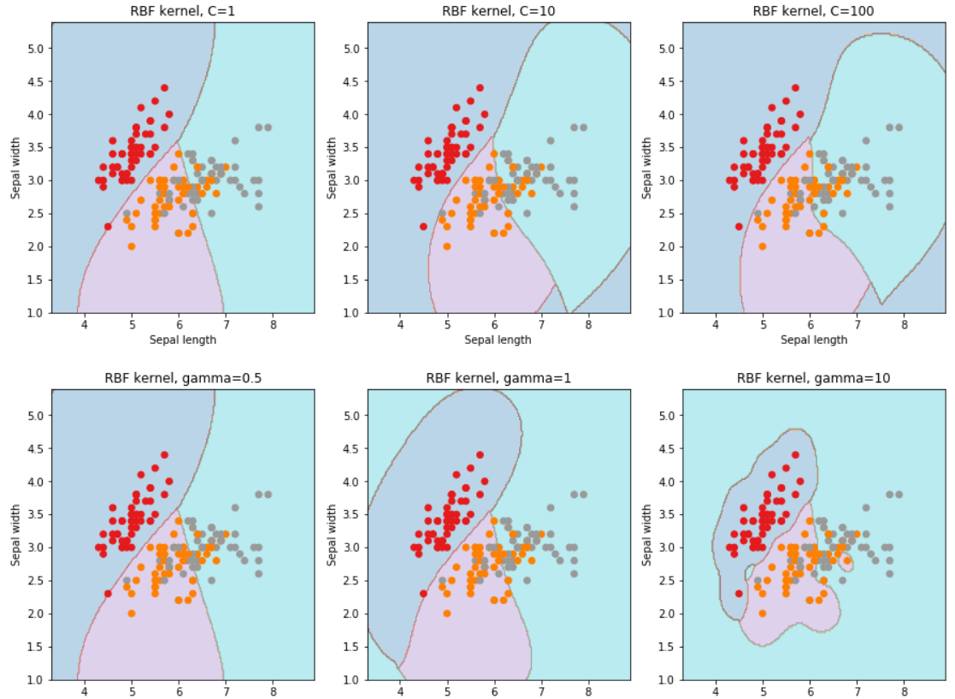
Example – RBF kernel
The RBF kernel function is:
You can see how the decision boundaries change with the meta-parameters C (it is the parameter of SVM) and γ (it is the parameter of the kernel function)

Slide 40
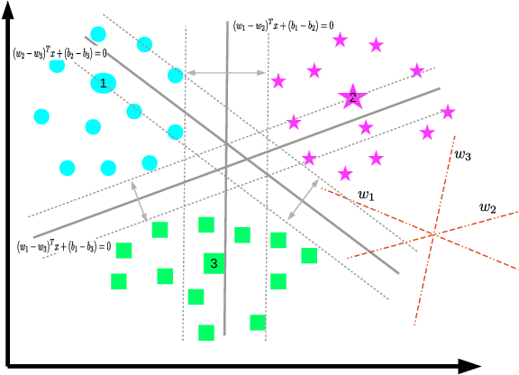
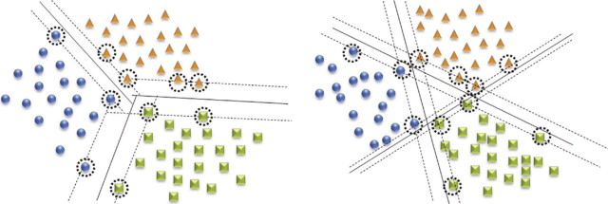
Multi-class SVM
It is not easy to extend SVMs to multi-class classification
…but as the simplest solution, one can always use the “one against the rest” or the “one against one” method presented earlier

Slide 41
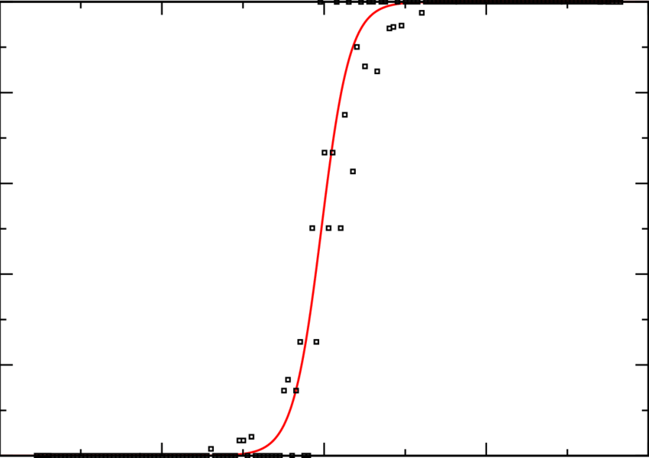
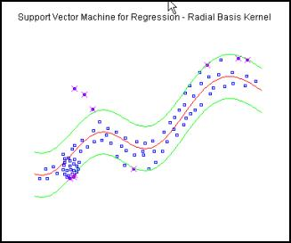
Further SVM extensions
Probability estimation
The SVM outputs (i.e. g(x)) cannot be directly interpreted as posterior probability estimates.
There exists several solutions to convert their outputs to probability estimates, but these are just approximations
e.g. Platt scaling: sigmoid of distance
SVMs have several extensions which allow them to solve regression tasks instead of classification

Slide 42
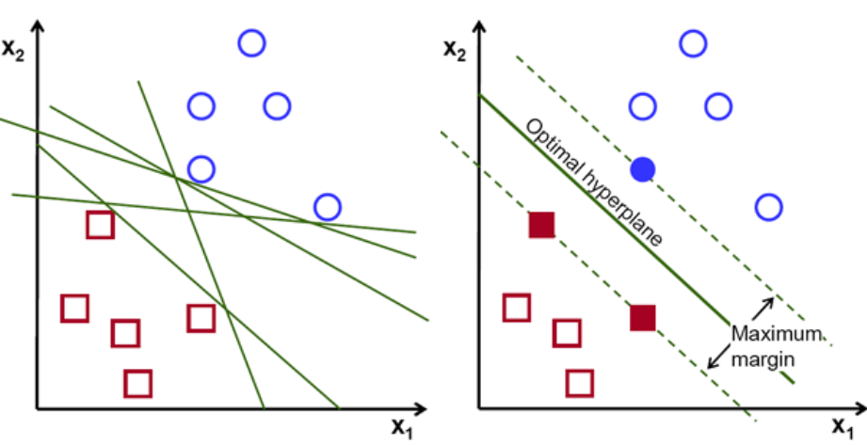
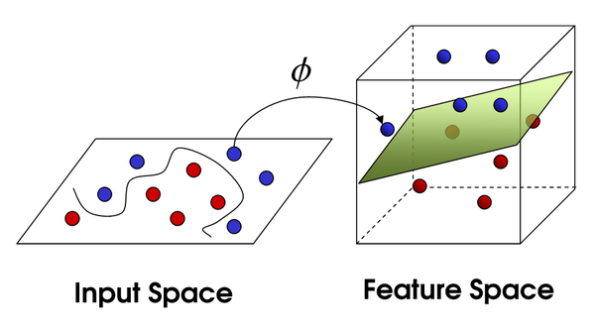
SVM – Summary
Advantages:
It is based on a nice theory
It has good generalization properties (not inclined to overfitting)
It is guaranteed to find the global optimum
With the “kernel trick” it is able to find non-linear discriminant functions
The complexity of the learned classifier depends on the number of support vectors found, not on the number of training samples, nor on the number of dimensions of the transformed space

Slide 43
SVM – Summary #2
Disadvantages:
The quadratic programming optimization is computationally more expensive than most of the other machine learning methods
Choosing the optimal kernel function is difficult
Kernel function → a further hyperparameter

